Slide 1
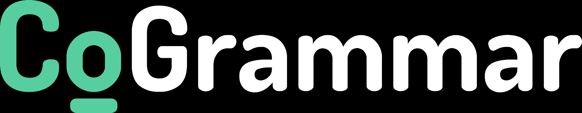
Welcome to the
Web Scraping
The session will start shortly…
Questions? Drop them in the chat. We'll have dedicated moderators answering questions.

Slide 2

Data Science Session Housekeeping
The use of disrespectful language is prohibited in the questions, this is a supportive, learning environment for all - please engage accordingly. (Fundamental British Values: Mutual Respect and Tolerance)
No question is daft or silly - ask them!
There are Q&A sessions midway and at the end of the session, should you wish to ask any follow-up questions. Moderators are going to be answering questions as the session progresses as well.
If you have any questions outside of this lecture, or that are not answered during this lecture, please do submit these for upcoming Academic Sessions. You can submit these questions here: Questions

Slide 3
Data Science Session Housekeeping cont.
For all non-academic questions, please submit a query: www.hyperiondev.com/support
Report a safeguarding incident: www.hyperiondev.com/safeguardreporting
We would love your feedback on lectures: Feedback on Lectures

Slide 4
Important Notice
Please check your spam folders for any important communication from us. If you have accidentally unsubscribed, please reach out to your support team.

Slide 5
Skills Bootcamp
8-Week Progression Overview
Fulfil 4 Criteria to Graduation
✅ Criterion 2: Mid-Course Progress
60 Guided Learning Hours Data Science - 13 tasks
Software Engineering - 13 tasks
Web Development - 13 tasks
Due Date: 28 April 2024
✅ Criterion 1: Initial Requirements
Timeframe: First 2 Weeks
Guided Learning Hours (GLH): Minimum of 15 hours
Task Completion: First four tasks
Due Date: 24 March 2024
Notes:
Graduation from the Skills Boot Camp requires fulfilling four criteria: initial requirements within the first two weeks, mid-course progress by week 4, course progress at the end, and demonstrating employability post-graduation. In order to successfully graduate from the Skills Bootcamp, you'll need to meet four key criteria. The first criterion, covering the initial requirements, must be fulfilled within the first two weeks of the program. This includes a minimum of 15 guided learning hours and the completion of your first four tasks.
The second criterion for mid-course progress has a deadline by week 8, where you are expected to complete a specific number of tasks depending on your track - 60 GLH & 13 Tasks

Slide 6
Skills Bootcamp
Progression Overview
✅ Criterion 3: Course Progress
Completion: All mandatory tasks, including Build Your Brand and resubmissions by study period end
Interview Invitation: Within 4 weeks post-course
Guided Learning Hours: Minimum of 112 hours by support end date
(10.5 hours average, each week)
✅ Criterion 4: Demonstrating Employability
Final Job or Apprenticeship Outcome: Document within 12 weeks post-graduation
Relevance: Progression to employment or related opportunity
Notes:
Moving on, the third criterion involves completing all mandatory tasks and resubmissions by the end of your study period and securing an interview invitation within four weeks post-course. Finally, the fourth criterion focuses on demonstrating employability, which includes documenting a final job outcome within 12 weeks post-graduation.

Slide 7


Web Scraping
June 2024
Notes:
Welcome to the Grammar Skills Bootcamp Orientation for November 2023. Today, we will cover several important aspects of this program to ensure you have all the information needed for a successful learning experience.

Slide 8

Learning Objectives
Understand Web Scraping and its importance.
Understand the fundamentals of HTML to effectively navigate and extract data from web pages.
Learn how to use Python Libraries for parsing HTML and automating web scraping tasks.
Explore ethical considerations in web scraping.
Combine web scraping with Natural Language Processing (NLP) techniques.
Notes:
Mention moderators and Questions tab. Our agenda includes an introduction to CoGrammar, details about student success support, graduation criteria, guided learning hours, learning tools and platforms, an overview of the Skills Bootcamp, and career services.

Slide 9
Web Scraping
Introduction

Slide 10
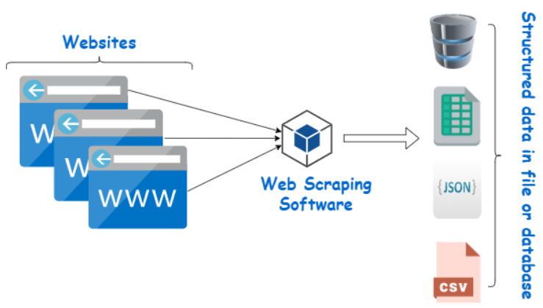
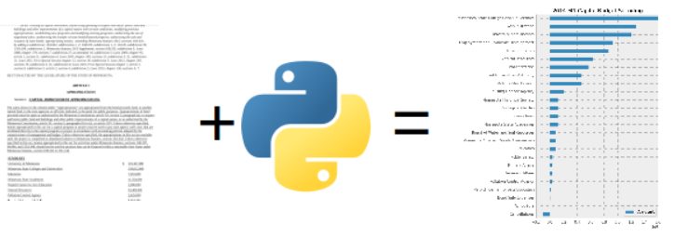
Web Scraping
Web scraping is the process of automatically extracting data from websites.
Most websites do not allow you to save or download this data. If you need the data, the only option is to manually copy and paste the data - a very tedious job which can take many hours or days to complete.
Web Scraping is the technique of automating this process, so that instead of manually copying the data from websites, the Web Scraping software will perform the same task within a fraction of the time.
Source: https://pbpython.com/web-scraping-mn-budget.html
Source: https://www.webharvy.com/articles/what-is-web-scraping.html

Slide 11
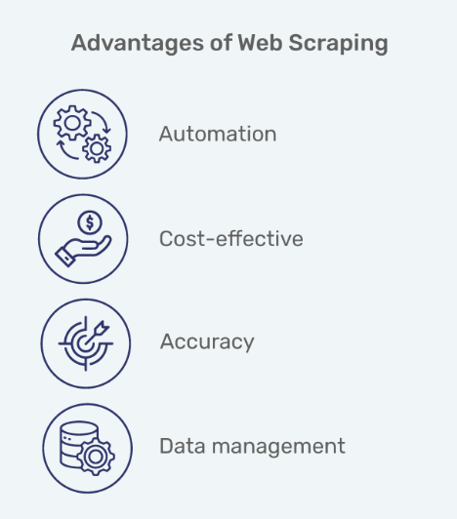
Importance of Web Scraping
Web scraping provides access to data that might not be available via APIs or datasets
It can provide real-time or frequently updated data, which can be crucial for many types of analysis
Scraped data can be used to train Machine Learning models for tasks like natural language processing (NLP) or image recognition
Source: https://www.mindbowser.com/how-does-web-scraping-work/

Slide 12
HTML

Slide 13
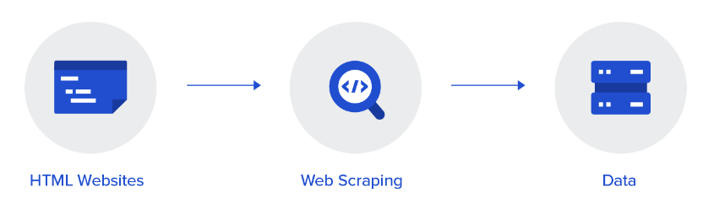
HTML
Familiarity with HTML (Hypertext Markup Language) is crucial for effective web scraping because it defines the structure and content of web pages.
This knowledge allows you to accurately identify, navigate, and extract data from websites and other online sources using web scraping tools.
Source: https://www.toptal.com/python/web-scraping-with-python

Slide 14
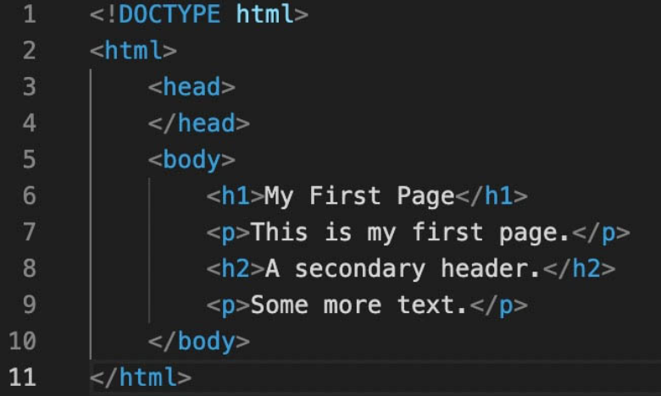
HTML
HTML consists of a set of elements (tags) that define the structure and content of a web page.
Each tag represents a different structure such as headings, paragraphs, images, tables, etc.
Tags are enclosed in angle brackets (`<>`) and they typically come in pairs e.g., `<p>` denotes the beginning of a paragraph and `</p>` denotes the end.
HTML elements are nested within each other forming a hierarchical structure known as the Document Object Model (DOM).

Slide 15
Importance for Web Scraping
Element Identification: Web scraping tools like Beautiful Soup or Scrapy rely on understanding HTML tags and their attributes to locate and extract specific data points. For example, if you want to extract the main heading in a page, you will look for a <h1> tag. Or, if you want to download images, you will look for the <img> tag.
DOM Navigation: The Document Object Model (DOM) represents the hierarchical structure of HTML elements on a web page. Knowing HTML allows you to navigate through this structure programmatically, which is essential for pinpointing where your desired data is located.
Data Extraction: HTML tags define different types of content and their relationships. By understanding HTML, you can precisely target and extract only the data you need for your analysis.

Slide 16
Python Libraries for Web Scraping
Beautiful Soup & Scrapy

Slide 17
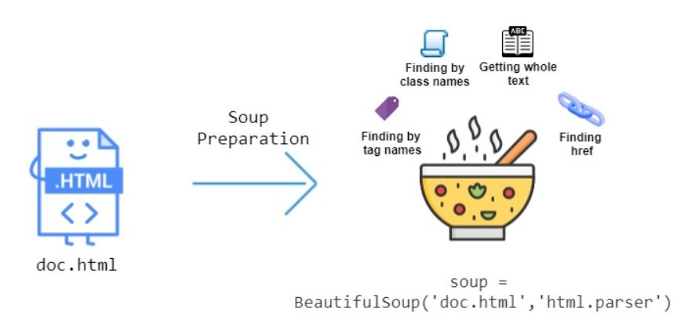
Beautiful Soup
Beautiful Soup is a Python library for parsing HTML documents, making it easy to extract data.
Beautiful Soup has methods and properties you can use to extract text, attributes, URLs and other content from HTML elements. You can navigate the DOM tree of a web page to locate specific elements based on tags.
It works well with other libraries like pandas for data manipulation tasks.
Source: https://stackabuse.com/guide-to-parsing-html-with-beautifulsoup-in-python/

Slide 18
Scrapy
Scrapy is a powerful web scraping framework that provides tools for scraping data from websites, handling requests, managing scraping agents, and storing scraped data.
Crawler Framework: Scrapy provides a framework for creating web crawlers (the scraping agents referred to as spiders) that can crawl websites, follow links, and extract data in a structured manner.
Beautiful Soup is good for simpler and quick data extraction from a few web pages. Scrapy is ideal for more complex projects involving crawling multiple pages, handling large volumes of data, and needing more control over scraping and data processing pipelines.

Slide 19
Web Scraping and NLP

Slide 20
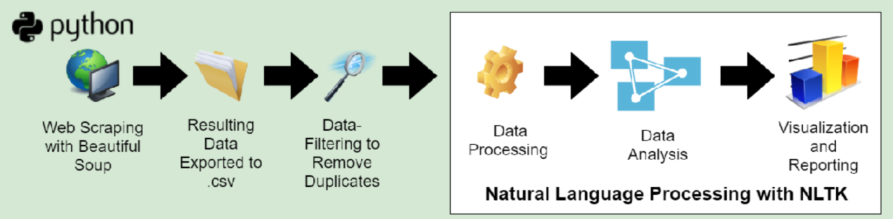
Web Scraping & NLP
Combining scraped data with NLP allows for deeper contextual understanding of the content we extract. We can analyse sentiments and themes expressed within the text, which is vital for understanding the opinions of contributors or consumers of web content.
Source: https://www.semanticscholar.org/paper/Utilizing-Web-Scraping-and-Natural-Language-to-Lunn-Zhu/a95e90c6c9c5753339e93548eebdcde1ea5b27e2

Slide 21
Web Scraping & NLP
Data Cleaning: Raw scraped data often contains noise (irrelevant information) or HTML tags. NLP techniques such as tokenisation, stemming, lemmatisation, and removing stopwords can clean and prepare the scraped data for further analysis.
Normalisation: Standardising text by handling special characters, and normalising spellings (e.g., converting "u" to "you") improves the quality of the corpus.
Entity Recognition, Text Classification & Sentiment Analysis: Scraped text can be processed to extract named entities (e.g., people, organizations) using NLP techniques. We can combine scraped data with NLP to understand trends, opinions, and sentiments expressed on the web. This is crucial information for processes such as opinion mining and topic modeling.

Slide 22
Ethics of Web Scraping

Slide 23
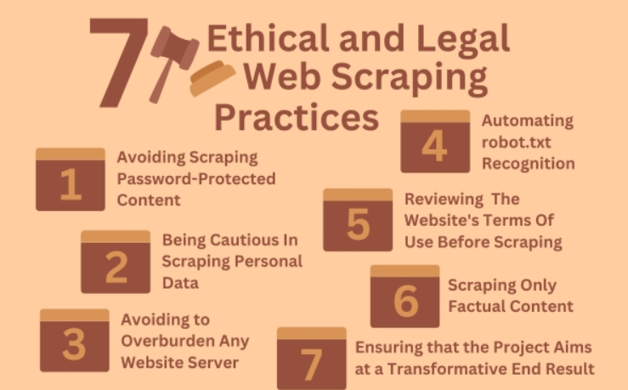
Ethics
When engaging in web scraping, it is essential to adhere to ethical guidelines:
Websites often have a robots.txt file that specifies which pages can be crawled. It's ethical to abide by these rules.
Ensure compliance with a website's terms of service regarding data usage and scraping.
Scraping should be done responsibly to avoid overloading servers and causing disruption.
Source: https://techjury.net/blog/is-web-scraping-legal/

Slide 24
Questions and
Answers

Slide 25

Thank you for attending

